Slide 1
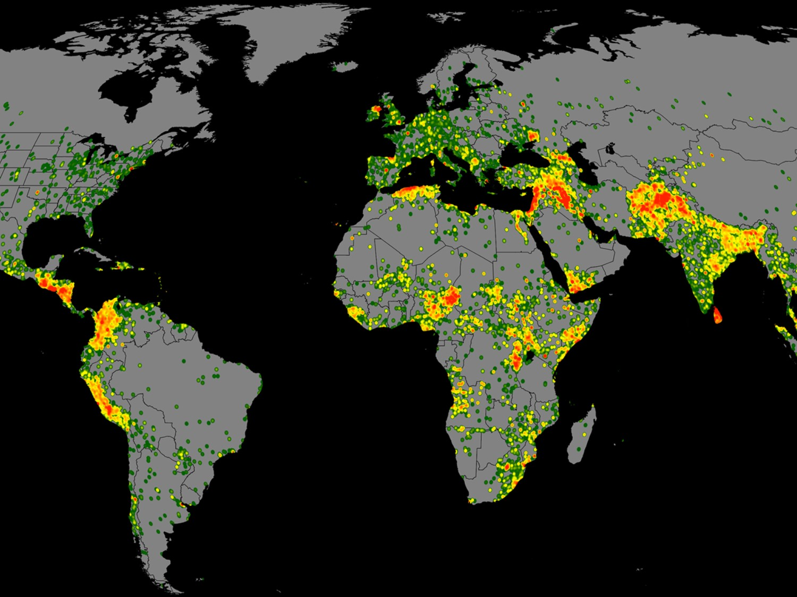
Analysis of Potential Terrorist And Perpetrators
By
Muhammad Umer EP 1449081
Khalid bin Huda EP 1449041

Slide 2
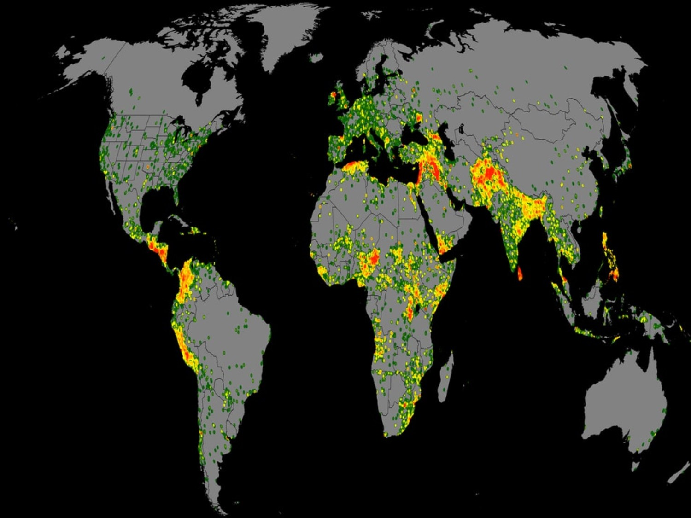
OUR GOAL
To Predict :
A person can be a Terrorist or Perpetrators

Slide 3
Agenda
• Problem Definition
• Data Source
• Data Preparation
• Data Exploration
• Modeling
• Classification
• Clustering
• Evaluation
• Shiny App

Slide 4
Problem Definition
Our problem is to predict the chance a person can be a Terrorist.
We used Classification and Clustering to predict the chances.
Attributes used : Marital Status Educational
Military , Madras training , Mental Illness
Islam , Sex , Age

Slide 5
DATA Source
data.world/sjhaveri
500 records
publicsafety/terror-attacks-list
412 record
Record dates
form 2000 to 2017

Slide 6
Data Preparation
Data cleaning: remove unnecessary Attribute
Such as Number of people Killed ,Status of Case, source
Data integration : merge the data file from tommy Blanchard and data.word and change attribute name to make it work.
Data transformation : Transform the data by merging the column such as First and last name, Home and nationality etc.

Slide 7
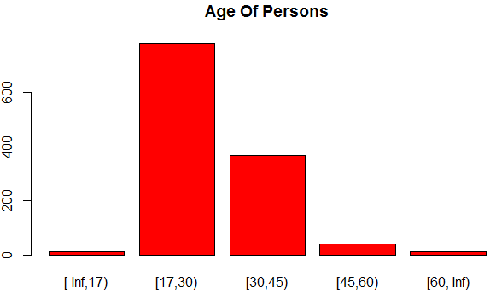
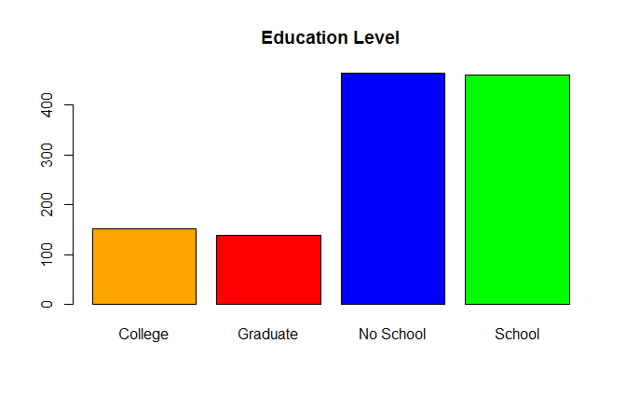
Data Exploration
Data Dimensions: 912 26
Main Attributes: Marital Status Educational Military , Madras training
Mental Illness, Islam , Sex , Age

Slide 8
MODEL USED
Classification
Decision Tree
Random Forest
Naïve Bayer(ShinyApp)
Clustering
Partitioning Around Medoids (PAM)

Slide 9
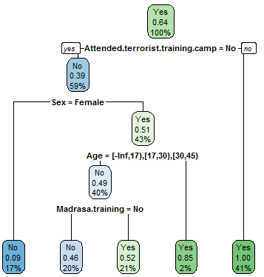
Classification
Decision Tree
rpart(as.factor(IsTerrorist)~Age + Attended.terrorist.training.camp + Sex +
Madrasa.training + MaritalStatus ,data = train,method="class")
Pred. | NO | YES
No | 81 | 80
YES | 100 | 287

Slide 10
Classification
Random Forest
myFormual <- IsTerrorist ~ Age + Attended.terrorist.training.camp + Sex +
Madrasa.training + Educational.attainment + MaritalStatus
rfmodel<-randomForest(myFormual,data = train,importance=TRUE)
Pred. | NO | YES
No | 193 | 68
YES | 6 | 340
Accuracy : 0.888
95% CI : (0.8601, 0.912)
Sensitivity : 1.0000
Specificity : 0.8357

Slide 11
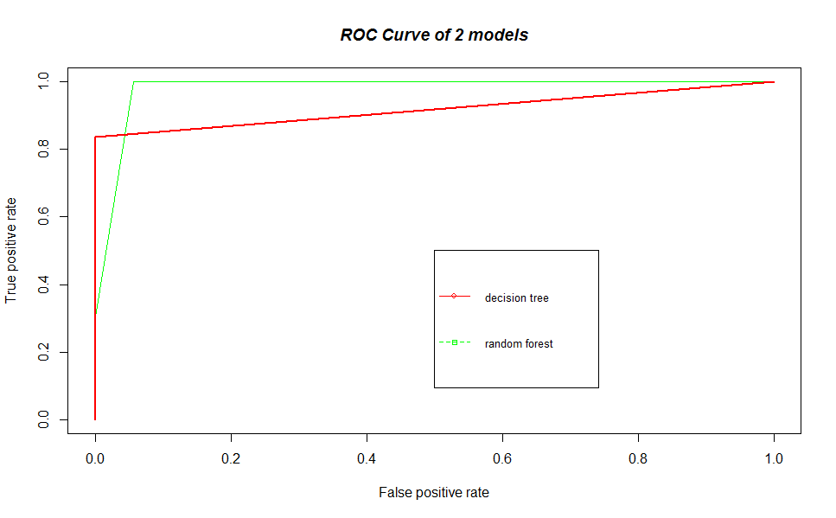
ROC curve

Slide 12
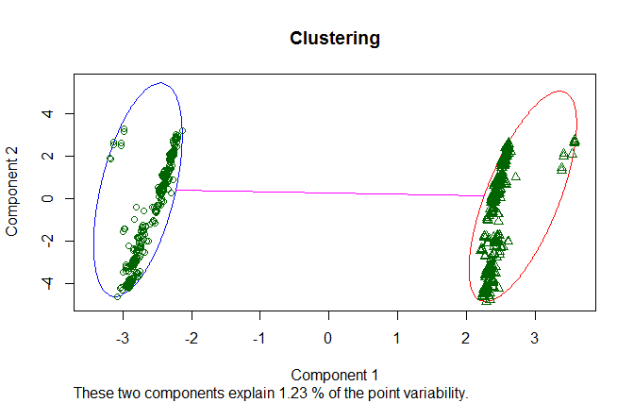
Clustering
PARTITIONING AROUND MEDOIDS (PAM) OBJECT
clus.avg.widths[1]
0.4262890 0.4180452

Slide 13

Shiny App
Model Used
Naïve Bayer
Library
e1071
It is an interactive web applications that helps us to predict from Our model in more easy and Reliable manner.

Slide 14
Shiny App
Description
The app predicts the probability of a person can be terrorist.
User Inputs
Military , Age, Madrasa Training, Mental Innless ,Educational, Gender, Islam
Plot
Plot between the Records of the Dataset and the predicted Probability by the model(naïve bayer)

Slide 15
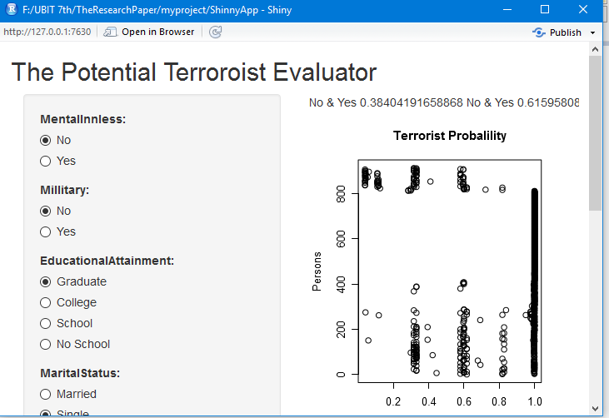
Shiny App
#Model
model <- naiveBayes(myFormula, data = dat )
RESULT
Graph
INPUT AREA

Slide 16
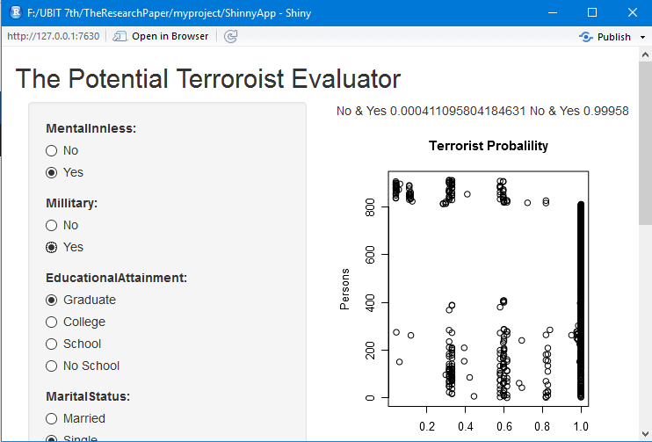
Shiny App
IF we change the Radio Button on left panel then Predicted probability on Right change as well, according to our model
RESULT
Graph
INPUT AREA

Slide 17
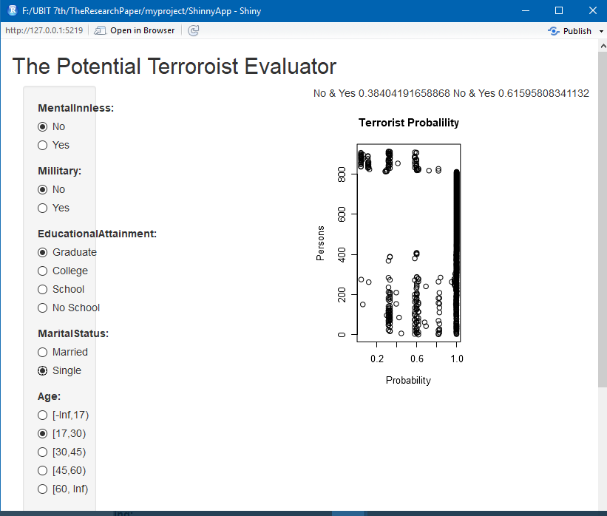
Shiny App
Now, we change the inputs and
Predicted value change according to it.
RESULT
Graph
INPUT AREA

Slide 18
Observation and Result
1- People aged from 17 to 30 are more likely to terrorist.
2- People with financial Issue more likely to become a terrorist.
3- All Muslim are not terrorist
RESULT
4- Student from Madrasa are more likely to become a terrorist
5- Generally in term of gender, male are more likely to be a terrorist.
Graph
6- Education Level has to relation with terrorism.

Slide 19
THANK YOU

